Slide 1
Business Process Reengineering

Slide 2
History
Introduced in the late
Business Review article.
Micheal Hammer’s 1990 Harvard
Promoted by Hammer and James Champy Reengineering the corporation.
published book
By the mid-1990s, BPR became popular as a justification for downsizing.
The next new methodology, after BPR is Enterprise Resource Planning.

Slide 3
Meaning
Business process reengineering (BPR) is the analysis and redesign of workflows within and between enterprises in order to optimize end-to-end processes and automate non-value-added tasks.

Slide 4
Business Process Reengineering(BPR)
Business Process: “A business process is a
collection of activities which some value to the customer”
together produces
Reengineering: Reengineering is fundamental rethinking and radical redesign.

Slide 5
Objective/Purpose of BPR
BPR focuses on processes and not on tasks, jobs or people BPR advocates that enterprises re-examines from basics aims at total re-invention not small improvements.
Example:
“Hewlett Packard’s assembly time for server computers reduces to low-4 minutes”

Slide 6
Seven Reengineering Principles
Organize around outcomes, not tasks.
Identify all the processes in an organization and prioritize them in order of
redesign urgency.
Integrate information processing work into the real work that produces the information.
Treat geographically dispersed resources as though they were centralized.
Link parallel activities in the workflow instead of just integrating their results.
Put the decision point where the work is performed, and build control into the process.
Capture information once and at the source.

Slide 7
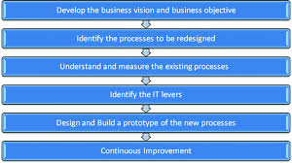
Business Process Reengineering Process

Slide 8
Step 1: Prepare for Reengineering
There must be significant need for the process to be reengineered. Identifying the customer driven objectives, the mission and vision statement is formulated
Step2: Map & Analyse As-Is process
Understand the existing process and its shortfalls and improvement areas of redesign.
Activity and process models are documented.
Then, the amount and cost of each activity is calculated.
Step3: Design To-Be process
The objective of this phase is to produce one or more alternatives to
the current situation that satisfies strategic goals of the enterprise.

Slide 9
Step4: Implement Reengineering Process
Using prototype and simulation method plans are designed and demonstrated.
Training programs for the workers are initiated and the plan is executed in full scale
Step5: Improving the reengineering process continuously
The progress of action is measured on change acceptance in broader perspective of the organisation, how well the employee are informed and their commitments
Monitoring the results measures employee attitude, customer perception, supplier responsiveness etc.,

Slide 10
Benefits of Reengineering
Eliminates waste, and obsolete or inefficient process
Significant reduction in cost and time
Revolutionary improvements in many business processes as measured by quality and customer service
Increasing the competency of both top and low level companies

Slide 11
BPR Management Technique Focused
Customer focus-Customer service oriented processes aiming to eliminate customer complaints.
Speed-Dramatic compression of the time it takes to complete a task for key business processes.
Flexibility- Adaptive processes and structures to changing conditions and competition.
Quality-Obsession with the superior service and value to the customers.
Innovation-Leadership through imaginative change providing to organization competitive advantage.
Productivity-Improve drastically effectiveness and efficiency.

Slide 12
APPLICATION
Many public and private sector organizations and SMEs Word-wide had undergone major reengineering efforts.
The technique was applied first to multinational cooperation's, such as IBM, SONY, GENERAL ELECTRIC, WALL MART, HEWLLET PACKARD, KRAFT FOODS having as a result major downsizing in their organizational structures
Later, the banking sector began to reengineer with a great degree of success such as CITIBANK , NORTHWESTERN BANK, BANK OF AMERICA and others.
Major utility companies used reengineering as a technique to improve service like OTE.

Slide 13
This technique was becoming well known to the business
sector
Today most SMEs are investigating the re-engineering technique and a lot of them are applying re-engineering.
Most of the times re-engineering is applied as a "must" when innovative IT tools are introduced to SMEs. Tools such as SAP, BAAN and various ERP systems that promote the horizontal organizational structure.

Slide 14
Types of firms / Organizations that BPR can be Applied
BRP could by implemented to all firms (manufacturing firms, retailers,
services, etc.) and public organizations that satisfy the following criteria:
Strong management commitment to new ways of working and innovation.
Well formed IT infrastructure
Business Process Reengineering could be applied to companies that confront problems such as the following:
High operational costs
Low quality offered to customers
High level of ''bottleneck" processes at pick seasons
Poor performance of middle level managers
Inappropriate distribution of resources and jobs in order to achieve maximum performance, etc.

Slide 15
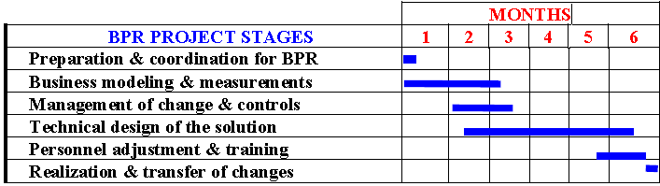
Duration and Implementation cost of BPR
Duration
The BPR technique, in general, is not a time consuming process. The duration of each BPR project varies from 6 -to 10 months. This variation relates to the kind of business and the extend to which BPR is going to be implemented.
For instance, BPR HELLAS, using the RE-engineering Methodology Oriented towards Rapid Adaptation proposes the following time schedule.

Slide 16
Implementation Cost
The cost of a BPR for projects applied to SMEs for selective processes varies depending on the complexity of the business environment and the number of processes

Slide 17

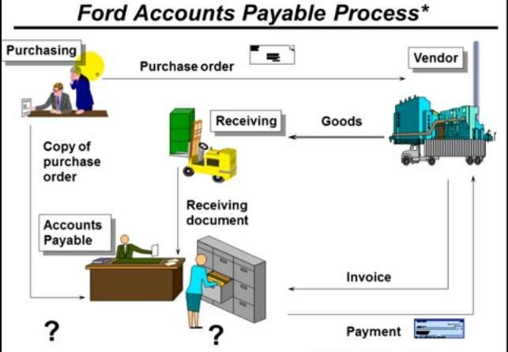
Case Study

Slide 18

Trigger For Ford’s AP Re-Engeeniring
Mazda only uses 1/5 personnel to do the same Accounts payable .(Ford:500; Mazda:5)
When goods arrive at the loading dock at Mazda:
-Use bar-code reader is used the loading dock at Mazda.
- Inventory data are updated.
-Send electronic payment to the supplier.

Slide 19
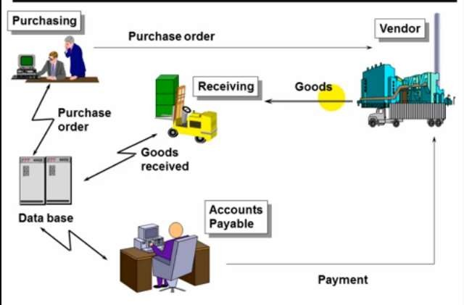
After BPR in Ford AP.

Slide 20

Ford Accounts Payable
Before
More than 500 accounts payable clerks matched purchase order, receiving documents and invoices and then issued payment.
It was slow and burdensome.
Mismatches were common. After
The new process cuts head count in AP by 75%.
Invoices are eliminated.
Matching is computerized.
Accuracy is improved.

Slide 21
How can you Re-Engineer your own Business Process
Assemble a re-engineering team representing each unit in the process and those that depend on it.
Make sure that they analyze and scrutinize the process until they understand what it’s trying to accomplish.
Determine which of the steps do not add value to the process and think of new ways to achieve the results.
If may not be obvious question everything.

